Slide 1



Data Lakes vs. Data Hubs Which one is right for you? (v 2.2)
Dan McCreary
President, Kelly-McCreary and Associates
dan@danmccreary.com
@dmccreary
http://www.linkedin.com/in/danmccreary

Slide 2
Agenda
Introductions
Define Data Lakes and Data Hubs
Why both Data Lakes AND Data Hubs are better than RDBMS for many business problems
Common attributes
Key differences
Case Study: Building an infrastructure for AI/Deep Learning
A proposed objective selection process (ATAM)
Notes:
We will start with a slow and careful definition of our terms and topics. We will then compare and contracts different integration architectures.

Slide 3
How many people…
…have ever heard of a Data Lake or Data Hub?
…are using a Data Lake or Data Hub today?
…are considering building a Data Lake or Data Hub?

Slide 4
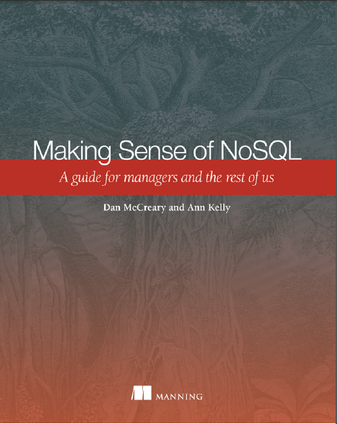

Background for Dan McCreary
Co-founder of "NoSQL Now!" conference
Coauthor (with Ann Kelly) of "Making Sense of NoSQL"
Guide for managers and architects
Focus on NoSQL architectural tradeoff analysis
Basis for 40 hour course on database architectures
How to pick the right database architecture
http://manning.com/mccreary
Focus on metadata and IT strategy (capabilities)
Currently focused on Artificial Intelligence Training Data

Slide 5
Six Database Core Architecture Patterns
Relational
Analytical (read-mostly OLAP)
Key-Value
key
value
key
value
key
value
key
value
Column-Family
Graph
Document
Which architectures are best for data lakes and data hubs?
Notes:
File systems (like HDFS) store a path to a file (the key) and the value of the file in a opaque blob that can not be queried.
Most data lakes use key-value stores where the values have no indexes.

Slide 6
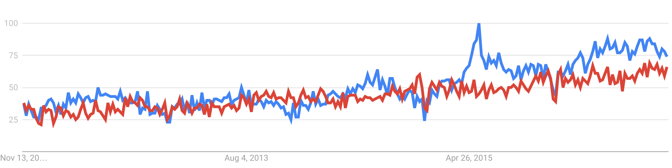
Google Trends
Data Lake
Data Hub

Slide 7
Horizontal Scalability
Performance
Linear scalable architectures provide a constant rate of additional performance as the number of processors increases
Non-scalable systems reach a plateau of performance where adding new processors does not add incremental performance (Relational and Graph)
Linear Scalable
Non-Scalable
Nodes in Cluster
Unlike most RDBMS systems, both Data Lakes and Data Hubs have inherent horizontal scalability

Slide 8
Data Lake Definition
~10 TB and up
A storage repository that holds a vast amount of raw data in its native format until it is needed.
Examples of raw native format:
Dump of data from an RDBMS in csv format
Export data with many numeric codes
Log files
http://searchaws.techtarget.com/definition/data-lake

Slide 9
Data Lake Assumptions
Scale-out architecture
Adding more data won't slow down reads
No "joins" are ever used to access data
Consistency
Consistent read and write performance, even under heavy load
High availability and tunable replication
Default replication factor = 3
No secondary indexes
Low cost
$500/TB/year (Amazon S3 is at under $360/TB/year)

Slide 10
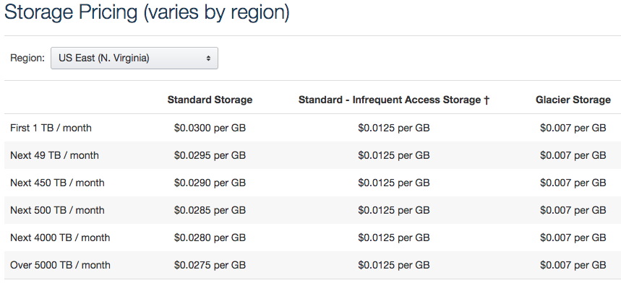
Amazon S3 Pricing (Nov. 2016)
36 cents/GB/year = $360/TB/year
SLA Design:
5 9s availability (you can read your data at any point in time)
11 9s durability (your data will not get lost)
Price has never gone up (only down)

Slide 11
Implemented with a distributed fault-tolerant parallel file systems
Hadoop
Hadoop Distributed File System HDFS
Amazon S3
Cloud based object store
Other Distributed File Systems:
Ceph (OpenStack)
GlusterFS (now owned by Red Hat)
GNU Cluster File System
Lustre
https://en.wikipedia.org/wiki/List_of_file_systems#Distributed_parallel_fault-tolerant_file_systems

Slide 12
Data Hub Definition
Meaningful to data subscribers
A collection of data from multiple sources organized for distribution, sharing,
and subsetting.
Generally this data distribution is in the form of a hub and spoke architecture.
A data hub differs from a data lake by homogenizing data and possibly serving data in multiple desired formats, rather than simply storing it in one place, and by adding other value to the data such as de-duplication, quality, security, and a standardized set of query services.
You can query it!
https://en.wikipedia.org/wiki/Data_hub (Nov. 2016)

Slide 13
Data Flow Comparison
Data Lake
Data Hub
Applications
Applications
Data Service
CSV Dumps
Data
Hub
Applications
Data Service
Distributed File System
Applications
Data Service
Log Files
Sub-millisecond response times
Batch Analysis
Not real-time
Which one generates web pages?
Notes:
Note that Data Lakes are focus on getting dumps of large data sets and doing cist-effective batch analysis.
Data Hubs focus on building sub-millisecond response times.
Ask: Which architecture builds web pages?

Slide 14
Sample Data Hub Data Flow Diagram
Canonical
Harmonized
Egress APIs
(REST web services)
Staging
http
put
http
get
XML
Semantically Precise
Data
JSON
mlcp
Raw Data
search
Transform
Extract
RDF
Bulk load
ODBC
dashboard
One doc per object
validate
One doc per row
XML Schemas (data quality)
Metadata and Reference Data (semantics)

Slide 15
AI Driven Strategies
Canonical
Harmonized
Machine Learning Services
(REST web services)
Staging
Training Set
Graphical
Processing
Units (GPU)
Feature
Scaling
Semantically Precise
Data
Model
Parameters
Raw Data
Transform
Transform
Mean
Normalization
One doc per object
validate
AI Applications
One doc per row
Predictions
XML Schemas (data quality)
Metadata and Reference Data (semantics)

Slide 16
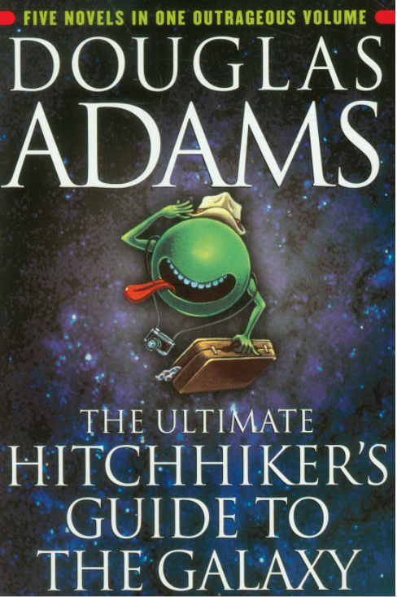
How do data lakes answer the question…
What is the answer to life, the universe and everything?
<answer>42</answer>
Notes:
The answer is given in a numeric code without the label. Data Lakes store their data in numeric forms, without clear semantics.

Slide 17
Seven Levels of Semantics
Typical CSV data
What does this mean?
Low Semantics
1
2
3
4
5
6
7
<INDGENCD>42</INDGENCD>
<Gender>42</Gender>
<PersonGenderCode>42</PersonGenderCode>
<PersonGenderCode>F</PersonGenderCode>
<PersonGenderCode>Female</PersonGenderCode>
<c:PersonGenderCode>Female</c:PersonGenderCode>
Low
Data
Governance
Data
Stewards
RDF (next page)
Clear Meaning
Search Friendly!
High Semantics
xmlns:c="http://example.com/canonical-reference-data
Notes:
In a data hub, data is converted from simple numeric codes to searchable data. Numeric codes move to semantically meaningful systems. Data element names move from ambiguous to clear. Data stewardship is assigned to the correct individuals.
Why use a namespace? Because it ties it directly to data quality tools like XML Schemas.
The seven stages of data representation. Stage 7 is RDF where the "data assertion" is given in URLs

Slide 18
Resource Description Format
http://example.com/canonical-reference-data/Person
Subject
http://example.com/canonical-reference-data/GenderCode
Predicate
"Female"
RDF breaks each assertion into Node-Arc-NodeSubject-Predicate-Object Relationships
Subject and Predicates are URLs. Objects are sometimes "literal" strings
If all imported data used RDF than transformation and integration would be trivial (no ETL)
Object

Slide 19
The Semantic Spectrum
Low Semantics
High Semantics
Data Lake
Data Hub
Mostly Numeric Codes
No harmonization
Write and read by the source application
No namespace and validation
No data quality
Numbers and labels
Incremental harmonization
Writes and read by everyone
Validation
Data quality for all egress documents
Note that high-semantics are not "free"
It requires a large framework of tools to convert numeric codes into useful labels

Slide 20
It's About Building Integrated Views
Integrated views of customers - every touchpoint visible by call center
Integrated views of hardware devices - every desktop, server, firewall etc.
Integrated views of whatever….

Slide 21
100% Failure Rate
The Old Way: Comprehensive Enterprise Modeling
First a brief word on the old approach. People used to (and occasionally still) build a new enterprise data model comprising every field and value in their existing enterprise, across all silos, and then map every silo to this new model in a new data warehouse via ETL jobs.
ITBusinessEdge surveyed companies and found that this approach always fails. Survey respondents report that it goes over budget or fails 100% of the time.

Slide 22
What they both have in common
They both have fantastic horizontal scalability (Yeah)!
No data modeling before you load your data! -> Agility, Flexibility
They both leverage low-cost shared-nothing commodity hardware
They both know how to reliably distribute computing loads over hundreds of processors
The both help organization understand the challenges of distributed computing

Slide 23
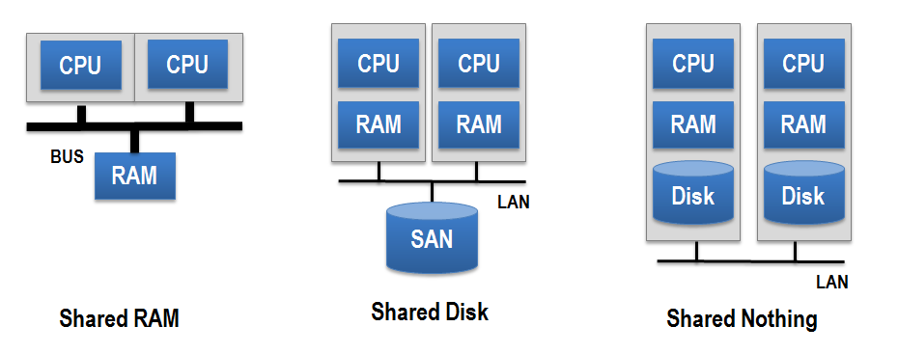
Shared Nothing Architecture
Every node in the cluster has its own CPU, RAM and disk

Slide 24
Fallacies of Distributed Computing
The network is reliable
Latency is zero
Bandwidth is infinite
The network is secure
Topology doesn't change
There is one administrator
Transport cost is zero
The network is homogeneous
L Peter Deutsch
https://en.wikipedia.org/wiki/Fallacies_of_distributed_computing
Notes:
You will learn about the complexities of true distributed computing models.

Slide 25
Data Hub Philosophy
Ingest everything
Index everything
Analyze everything from the indexes
Track data quality
Incrementally harmonize
Promote strong data governance and data stewardship
Make it easy to do transactions, search and analytics on harmonized data

Slide 26
Document-Centric Data Hubs
Relational
Analytical (OLAP)
Key-Value
key
value
key
value
key
value
key
value
Column-Family
Graph
Document
Document databases are ideal for many egress tasks
Graphs make it easy to link related documents together

Slide 27
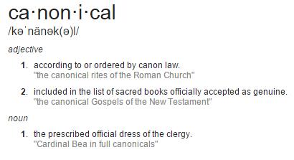
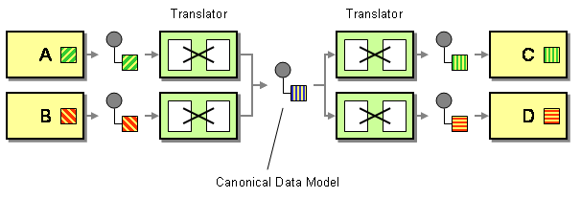
What is an Enterprise Canonical Model?
How can we minimize dependencies when integrating applications that use different data formats?
Design a Canonical Data Model that is independent from any specific application. Require each application to produce and consume messages in this common format.
http://www.enterpriseintegrationpatterns.com/CanonicalDataModel.html

Slide 28
Many-Component Specialized DB Cost Model
Data Warehouse
BI
Applications
ETL
Analytics
Transactional
(RDBMS)
historical
ETL
Search
(Solr, ElasticSearch)
Search
Many highly specialized databases
Each with their own strengths and weakness
Expensive ETL (batch and real-time) to keep databases in sync
Chargebacks based on CPUs and disk storage (not I/O)
Little understanding of the costs of moving data between systems
Total cost = RDBMS + ETL + DW + ETL + Search
Where do I store my metadata?

Slide 29
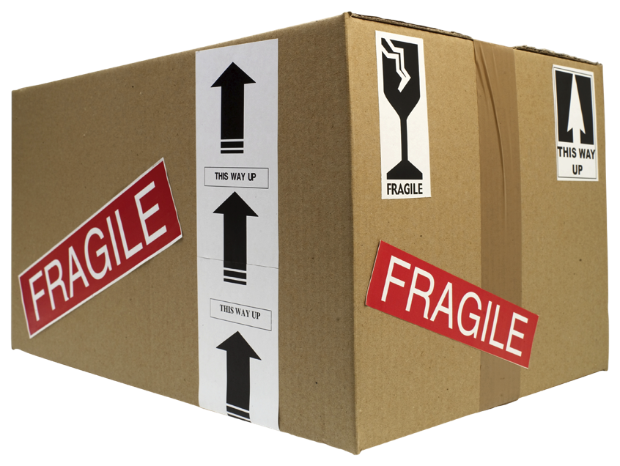
Traditional EDW (and ODS) Pain Points
Non-trivial delivery time and effort
Dependency on Extract, Transform and Load (ETL) and movement of a lot of data
Very brittle with respect to change
Not suited for unstructured data
Legacy RDBMS technology does not scale flexibly or economically
Notes:
Non-trivial delivery time and effort
Creation of canonical model(s)
Transformation, quality, governance, etc.
Dependency on ETL and movement of a lot of data
Very brittle with respect to change
Not very agile for today’s needs – “cost per column”
Exacerbated by 3-V’s challenges
Not suited for unstructured data
Legacy RDBMS technology does not scale well

Slide 30
Challenges with ETL
Designed for table-to-table transformations
Written in SQL with memory intensive "joins"
Difficult to scale
Difficult to re-use centralized business rules (no document validation)
Batch transforms typically run over night
Limited time windows
Little chance for recovery on errors

Slide 31
Ideal NoSQL Cost Model
Applications
BI
NoSQL
Search
Imagine a single database for:
All transactions
All Search
All Analytics
Use a scale out architecture with ACID transactions
Index everything for fast queries, search and deep analytics
Avoid moving data around
Total costs can be much lower!
Analytics

Slide 32
Why Use a Document Store?
Document stores are ideal when you have highly-variable data
Example: clinical healthcare data
Document stores can be designed to have a "scale-out" horizontal-scalable architecture
Unlike relational models, there are limited "join" operations
Simply add new nodes to a "cluster" and the system can "rebalance" and support higher volumes of data

Slide 33
How are Document-Centric Data Hubs Different?
Handles complex data
Does not fit well into a single table
Handles highly variable:
Example: healthcare.gov
37 states – 37 variations
Diverse users:
Examples: Clinical, Claims, Analytics, Search, Research, Pharma
High security and audit (PHI)
Requires role-based access control
Volume
Requires a true scale-out architecture

Slide 34
Three Functions – One Cluster – One Set of APIs
Operational Data Hub
Operational
Server
Analytics
Search
Combines a transaction safe application server, a database server and a search engine in the same server. Minimize data movement and ETL costs.

Slide 35
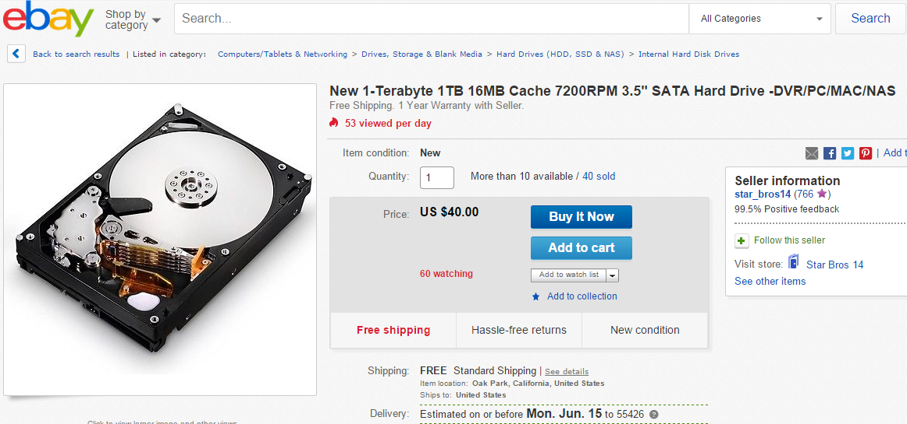
Data Storage Cost Models
Measured in dollars per TB per year ($/TB/Y)
TB = Terabyte
1 TB hard drives cost = $40 (qty 1)
Notes:
If disk space is so inexpensive, why not index everything?

Slide 36
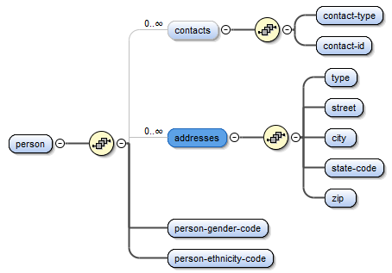
Comparison of Normal vs. Denormal Forms
Normalized
Denormalized Document
Contacts
Address
GenderCodes
Person
EthnicityCodes
RaceCodes
CitizenshipCodes
Purchases
Ratings
One document
Single line of code:
One join per child table
17 tables = 16 joins
get-person('123')

Slide 37
Sample Data Hub Data Flow Diagram
Egress APIs
(REST web services)
Staging
Canonical
http
put
http
get
XML
XML
XML
XML
XML
mlcp
XML
XML
JSON
search
XQuery
XQuery
RDF
Bulk load
JSON
ODBC
dashboard
One doc per row
One doc per object
validate
REST Queries
XML Schemas (data quality)
Metadata and Reference Data (semantics)

Slide 38
Definitions
Staging
Raw data
One document per row from RDBMS
Simple flat data
Canonical
De-normalized and enriched data
Semantically clear
Validated by XML Schemas
Egress
REST web services of high-quality data
May include the use of pre-calculated aggregates (materialized views) to speed analytical reports
Multiple formats
Many options
Strong SLAs (read times, high availability)

Slide 39
Reference Data
Data that is not associated with each new transaction
Data elements that use the "Code" suffix
ISO-11179 Representation Term
Based on standards
80% of the tables in CDB is reference data
Goal:
Consistent usage over time and between projects
Examples:
Gender Code
Ethnicity Code
US State Code

Slide 40
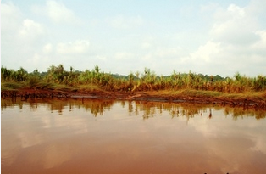

How to build semantically useful systems?
Muddy Data Lake
Clear Data Hub
Build Continuous Enrichment Pipelines
Raw Data
Index
Enrich
Validate
Score

Slide 41
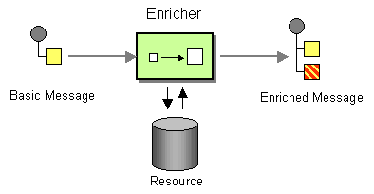
Content Enrichment
Continuous process of enriching content using resources from your data hub

Slide 42
Reference Data Enrichment Services
<column-5>42</column-5>
Enrichment
<c:PersonGenderCode>Female</c:PersonGenderCode>
Conversion of low-semantics elements to high-semantics and search friendly forms
Example:
Input: street, city, state
Output: add longitude and latitude

Slide 43
Data "Opaqueness"
Muddy
No precise definitions and validation for data elements and code values
Expensive to integrate into other systems
Difficult to generate consistent reports over time and across projects
No data stewardship and change control
No "enrichment" processes
Clear
Precise definitions for each data element and code values
Multiple sources continuously harmonized into canonical forms
Low cost to integrate and share with other systems
Designed for multiple purposes
Strong data stewardship and robust change control
Continual data enrichment
How clear are the semantics of our integration hub?

Slide 44
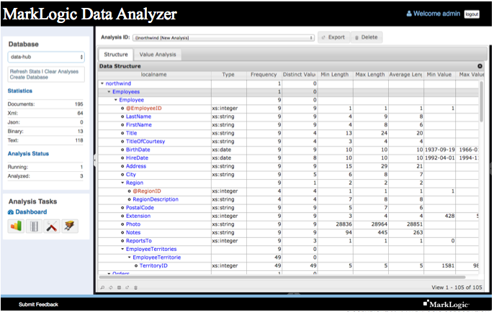
Data Analyzer / Data Profiler

Slide 45

Avoid Data Archaeology
Time consuming task of converting numeric representations to symbolic representations
Focus on strong metadata management and metadata services
What does
'42' mean?
XML Schemas (data quality)
Metadata and Reference Data (Semantics)

Slide 46
"Semantics" vs. "semantics"
Semantics with an uppercase "S" usually refers to the Semantic Web technology stack (RDF, SPARQL, inference)
semantics (with a lower case) usually refers to the process of creating shared meaning across multiple business units. This refers to the processes of Data Stewardship, Data Governance and metadata registries
Our recommendation is to use 90% documents and RDF (Semantics) to link documents
We do not recommend storing canonical documents in pure RDF

Slide 47
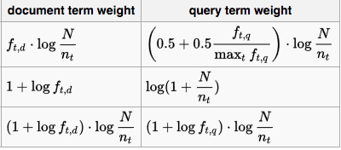
The Role of Search
Many systems don't integrate search well into their data
Calculating keyword density is hard
Calculating concept density is even harder
Great data hubs must come up with ways to make it easy to find the data you need

Slide 48
Applications tightly coupled to database
Application
Document web services?
Tightly Coupled
Database
CSV files with Low semantics
The root cause of many integration problems is that the application is tightly coupled to the database. Raw data dumped about of a typical RDBMS is almost useless without using the logic within and application.

Slide 49
Metcalf's Law
The value of a [system] is proportional to the square of the number of connected [systems].
https://en.wikipedia.org/wiki/Metcalfe%27s_law
Data Hub Value
10
Number of Connected Systems
Notes:
The value of a data hub will grow exponentially as you connect more systems.

Slide 50
Lower Incremental Costs
Incremental Cost Per Data Outbound Service
Number of Connected Systems
Each new outbound data service can leverage prior data loaded in the data hub.

Slide 51

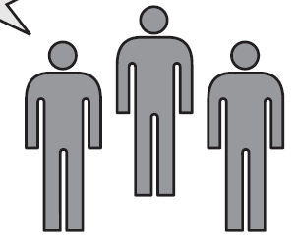
Role of the Solution Architect
Help!
Relational
Analytical (OLAP)
Key-Value
k
v
k
v
k
v
k
v
Column-Family
Graph
Document
Business Unit
Sally Solutions
Title: Solution Architect
Non-bias matching of business problem to the right data architecture before we begin looking at a specific products
Notes:
The role of the solutions architect is to select the RIGHT data architecture based on the requirements of the business unit.

Slide 52
Architecture Tradeoff and Analysis Method (ATAM)
Business
Drivers
Quality
Attributes
User
Stories
Analysis
Architecture Plan
Architectural
Approaches
Architectural
Decisions
Tradeoffs
Impacts
Sensitivity
Points
Non-Risks
Distilled info
Risk Themes
Risks
See Chapter 12 of Making Sense of NoSQL

Slide 53
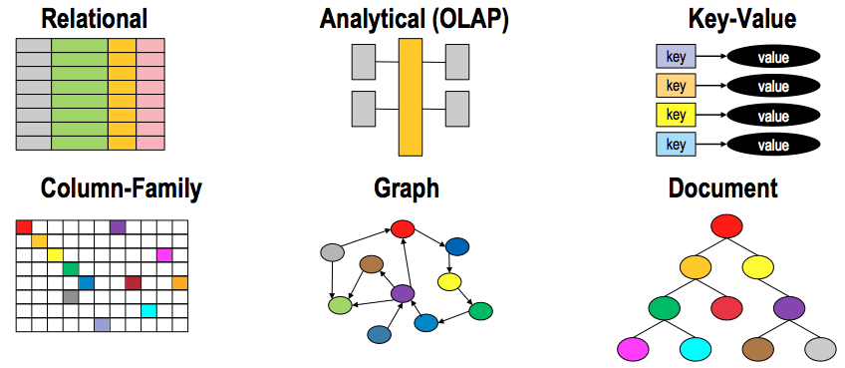
Architecture Tradeoff and Analysis Method (ATAM)
Business
Drivers
Quality
Attributes
User
Stories
Analysis
Architecture Plan
Architectural
Approaches
Architectural
Decisions
Tradeoffs
Impacts
Sensitivity
Points
Non-Risks
Distilled info
Risk Themes
Risks
See Chapter 12 of Making Sense of NoSQL

Slide 54
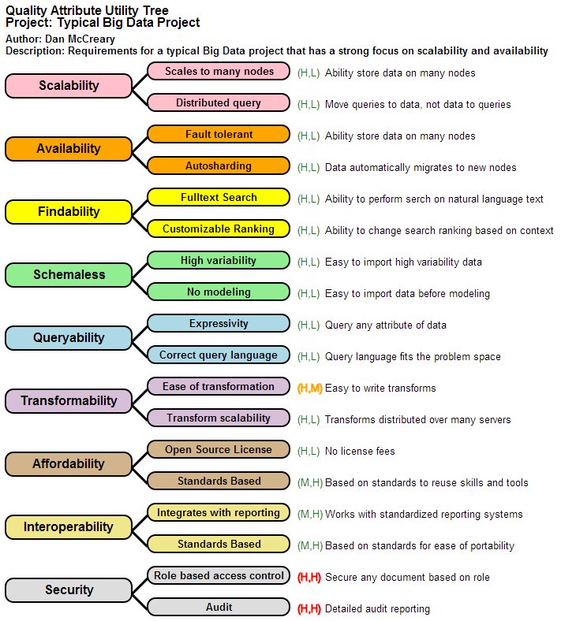
Quality Attribute Tree
How important
How difficult in any given architecture

Slide 55
Summary
Both Data Lakes and Data Hubs are great examples of distributed computing
Both have lower cost/TB/year than RDBMS and are far more flexible than an RDBMS
Be very cautious about doing integration on a RDBMS
Use Data Lakes for ways to store log files or some forms of RDBMS data
Use document and graph stores for building Data Hubs
Use Data Hubs to build integrated views of your customer

Slide 56
Further Reading and Questions
Thank You!
Dan McCreary
dan.mccreary@marklogic.com
@dmccreary
http://www.linkedin.com/in/danmccreary
http://manning.com/mccreary

